Slide 1

🎓 Smart Campus Portal
A centralized platform revolutionizing campus activities through integrated technology.
Presented By:
Abhishek Kumar — B.Tech CSE, 2nd Year, Galgotias University
Aditya Kumar — B.Tech CSE, 2nd Year, Galgotias University
Anshul Dubey — B.Tech CSE, 2nd Year, Galgotias University

Slide 2
Project Objective: Unifying Campus Operations
Our goal is to create a seamless digital ecosystem for enhanced campus management and user experience.
Centralized Platform Development
Integrated Technologies
Enhanced User Interaction
Harmonize JavaFX, JDBC, Servlets, OOP, Collections, and Multithreading for robust functionality.
Provide smooth and intuitive interactions for students, faculty, and administrative staff.
Develop a single, unified platform for all campus-related activities and information.
Data Accessibility & Efficiency
Scalability & Maintainability
Improve real-time data access and significantly reduce manual administrative workloads.
Ensure the system is built on a foundation that allows for future growth and easy maintenance.

Slide 3


Key Features: Empowering the Smart Campus
The portal integrates essential functionalities to streamline campus life and administrative tasks.
Online Attendance & Class Access
Automated attendance tracking via facial recognition or mobile credentials for accuracy.
Digital Noticeboards & Study Materials
Instant updates and seamless resource sharing, accessible anytime, anywhere.
Campus Services Integration
Unified access to meal plans, printing, parking management, and various payment options through a single application.
Communication Hub
Real-time messaging and collaborative tools fostering better interaction between students and faculty.

Slide 4
Object-Oriented Programming (OOP) Principles
Our system leverages core OOP concepts to ensure a robust, flexible, and well-structured architecture.
Inheritance
Polymorphism
Encapsulation
Base User class extended by Student, Faculty, and Admin for role-based access and shared attributes.
Different dashboard implementations providing tailored user experiences based on role.
Secure data handling and access control through well-defined getters and setters.
Abstraction
Exception Handling
Interfaces like FeedbackGiver facilitate a modular and extensible design.
Robust error management ensures system stability and fault tolerance.

Slide 5
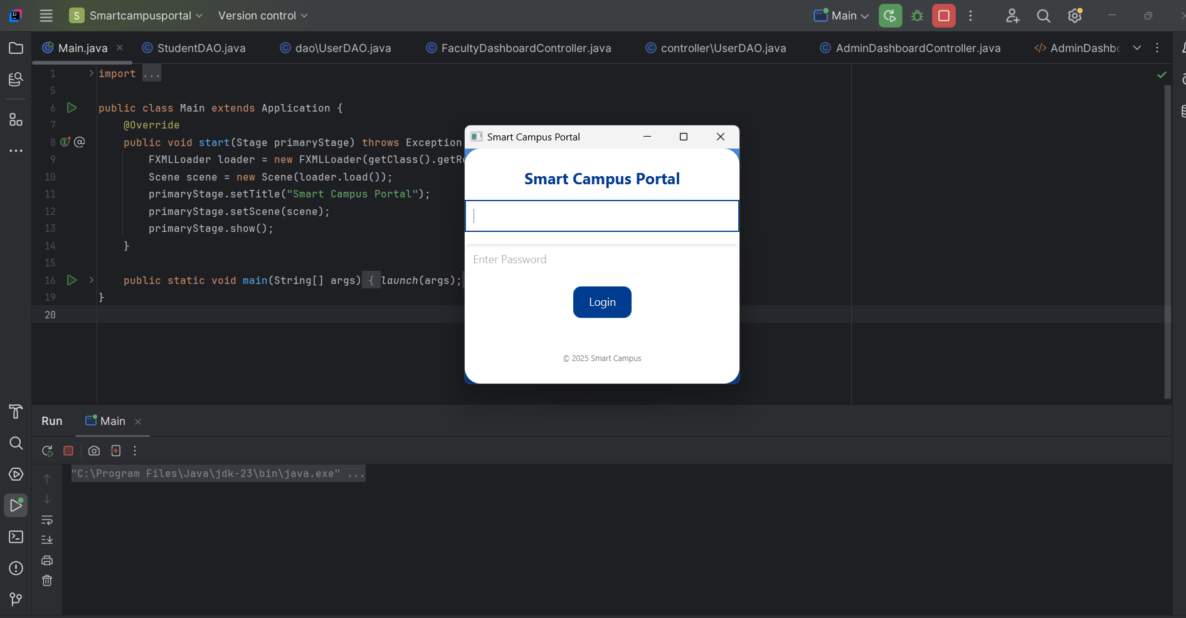
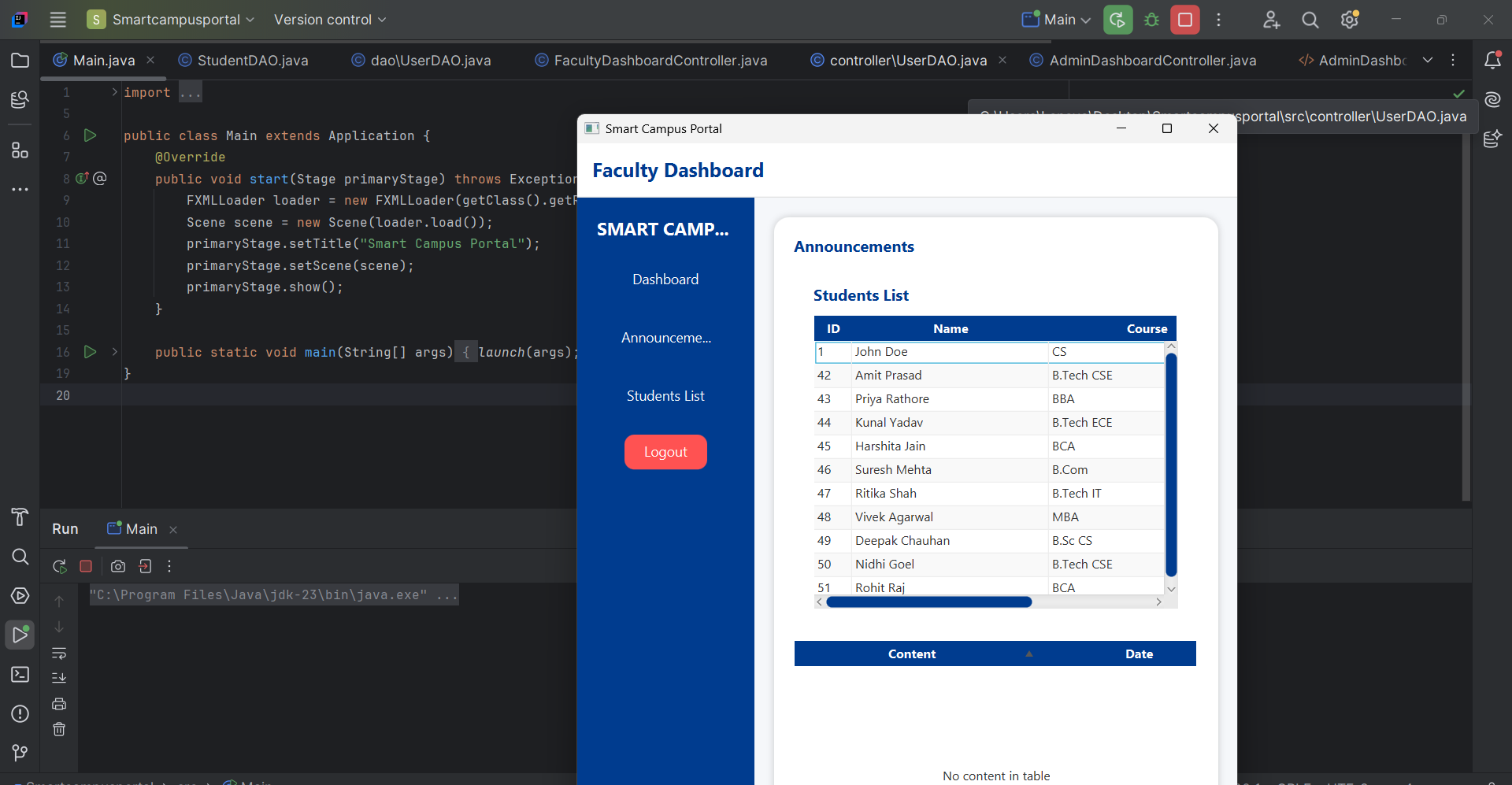
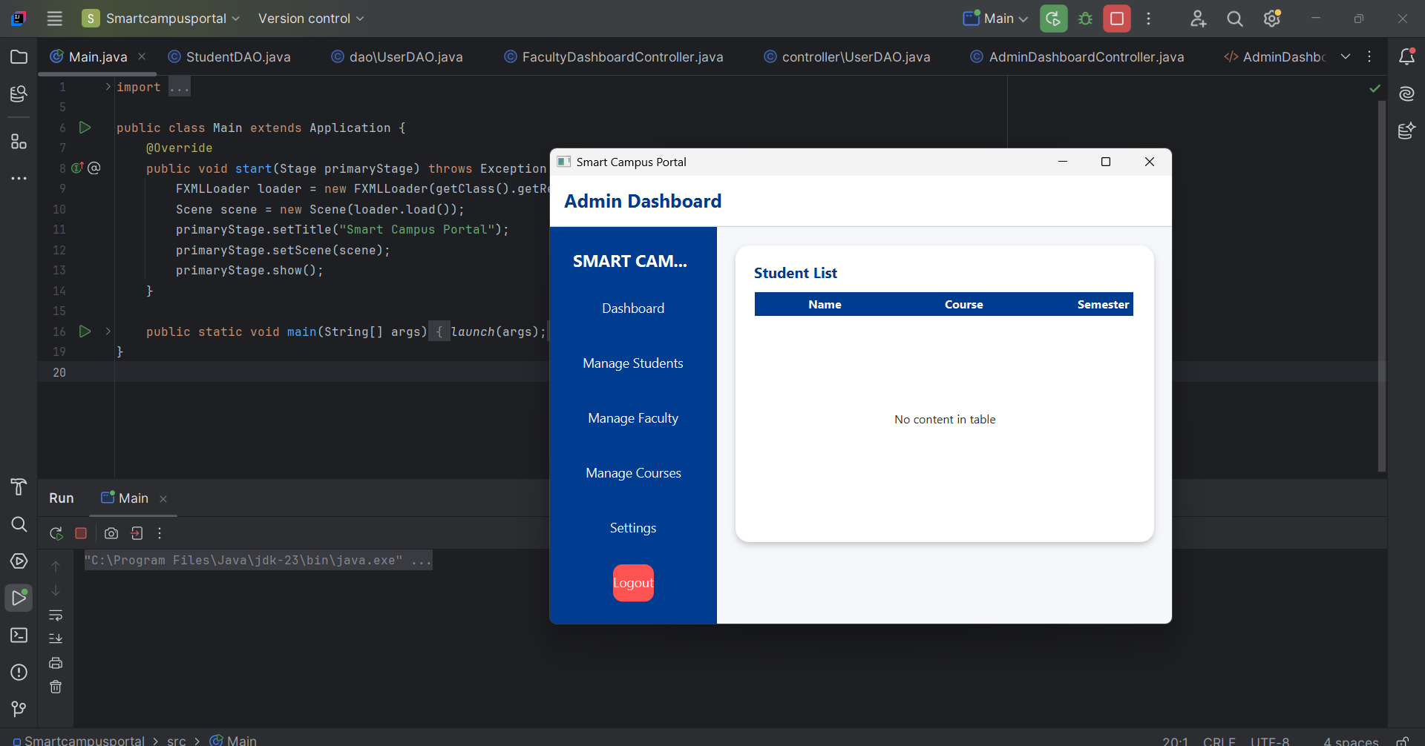

Slide 6

Database & DAO Layer: Data Integrity & Security
A secure and efficient database layer is critical for handling sensitive campus information.
JDBC Connection: Utilizes PreparedStatement for enhanced security and protection against SQL injection.
CRUD Operations: Comprehensive Create, Read, Update, and Delete functionalities for all core modules.
Separate DAO Classes: Ensures clean abstraction and separation of concerns for database operations.
Transaction Handling: Implements transaction management for multi-step updates, maintaining data consistency.
Optimized Queries: Designed for faster data retrieval and improved system performance.
The DAO (Data Access Object) layer provides a clear interface for interacting with the database, abstracting away implementation details.

Slide 7
Collections & Generics: Dynamic Data Management
Java Collections Framework and Generics are fundamental for managing and manipulating data efficiently within the portal.
ArrayList
HashMap
TreeSet
Dynamically stores and displays records, offering flexible size and easy element access.
Enables quick lookups and facilitates efficient data analytics within the system.
Maintains sorted and unique lists of data, such as courses or subjects.
Generic Utility Classes
Iterators
Promotes code reusability by creating type-safe functions for various data types.
Ensures safe and controlled traversal through collection elements, preventing concurrent modification issues.

Slide 8

Servlet Integration: Web-Based Interactions
Servlets power the web-based components of the portal, handling user requests and server-side logic.
LoginServlet
Manages user authentication, verifies credentials, and establishes secure user sessions.
FeedbackServlet
Securely processes and stores user feedback into the database for continuous improvement.
Secure Data Handling
All sensitive data is securely transmitted and processed using HTTP POST requests.
Session Management
Utilizes sessions to maintain user login states across multiple interactions.
Input Validation
Rigorous input validation prevents malicious data injection and ensures data integrity.

Slide 9
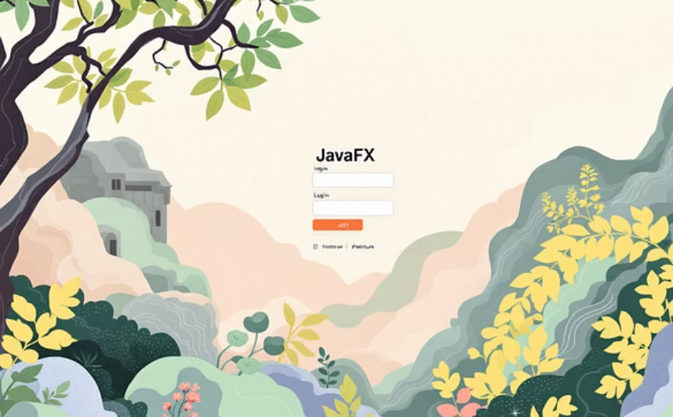

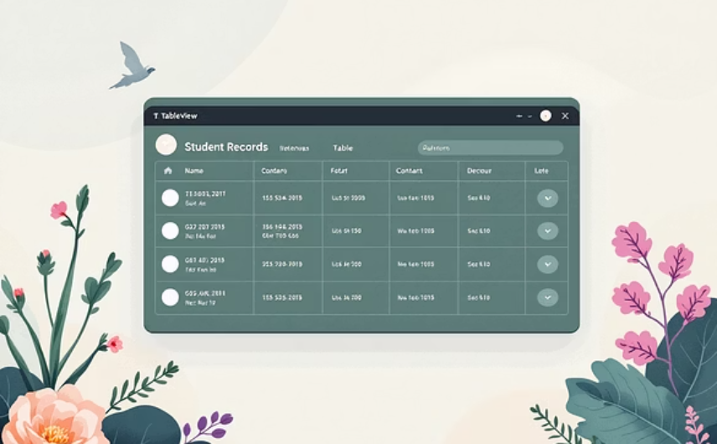

JavaFX GUI: Intuitive User Experience
The graphical user interface, built with JavaFX, provides an engaging and responsive interaction for all users.
User-Friendly Login: Animated login screen for an enhanced first impression.
Informative Dashboards: Personalized views for attendance, marks, and announcements.
TableView for Records: Clear and organized display of student and result records.
Performance Charts: Visual analysis tools for academic progress and comparisons.
Responsive Layout: Adapts seamlessly to various screen sizes for optimal viewing on any device.

Slide 10





Multithreading: Enhancing Responsiveness
Implementing multithreading ensures a smooth and non-blocking user experience, even during complex operations.
Background Data Loading
Heavy data operations are executed in separate threads, preventing GUI freezes.
Improved Responsiveness
Keeps the user interface fluid and interactive at all times.
ExecutorService
Manages scheduled and asynchronous tasks efficiently, optimizing resource utilization.
Thread-Safe Operations
Ensures data consistency and avoids conflicts in concurrent environments.

Slide 11
Conclusion: A Modern & Efficient Campus Portal
The Smart Campus Portal stands as a testament to effective software integration and design, delivering significant benefits to the university community.
1
2
3
Fully Functional System
Java Concepts Integration
Efficiency & Accessibility
A complete and operational Smart Campus Management System.
Successfully integrates all major Java programming concepts.
Significantly reduces manual effort and improves data accessibility.
4
5
Scalable & Future-Proof
Modern User Experience
Designed with scalability and future enhancements in mind.
Provides a secure, efficient, and user-friendly interaction.

